Slide 2
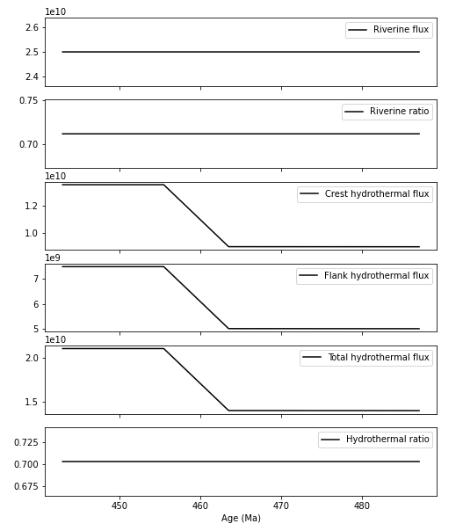
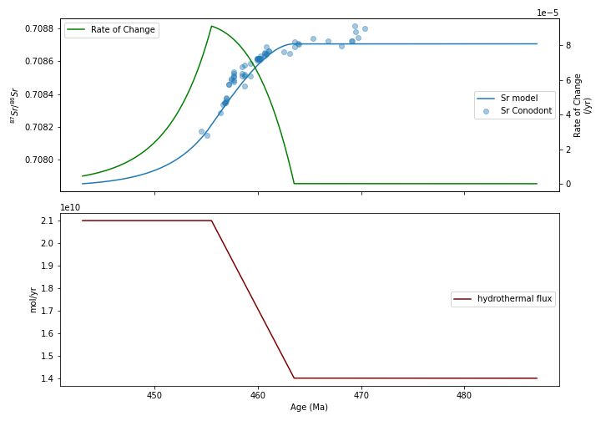
Model ver.0 (Ingram-style model)

Slide 3
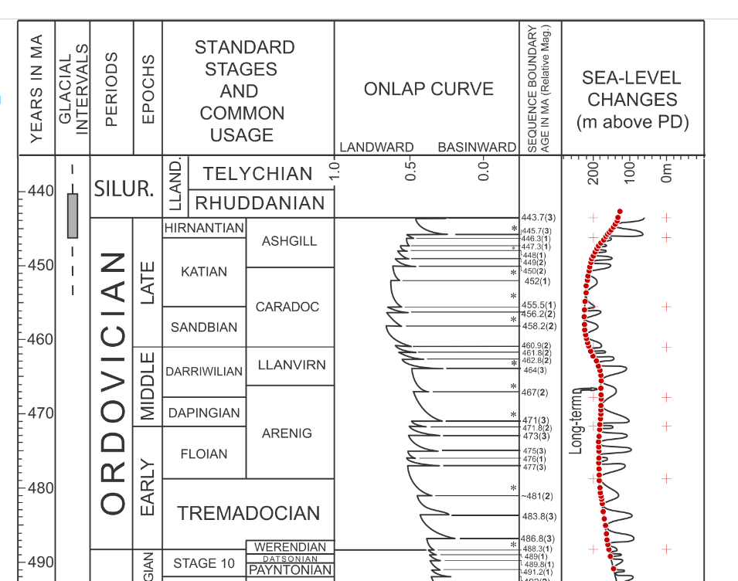
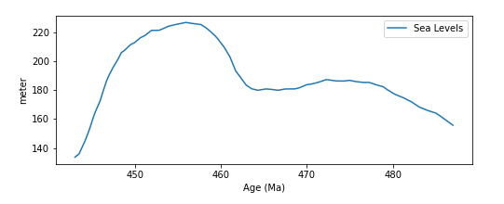
Model ver.01 (sea level curves driven model)
Hydrothermal Flux(t) = Jh0 x f(t)
where:
f(t) = sealevel(t) / mean_sealevel

Slide 4
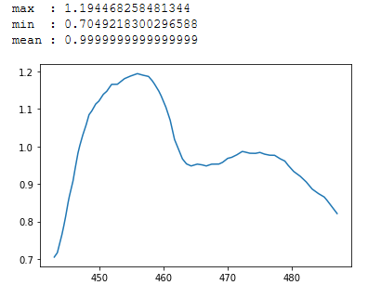
Model ver.01 (sea level curves driven model)
Hydrothermal Flux(t) = Jh0 x f(t)
where:
f(t) = sealevel(t) / mean_sealevel
f curve

Slide 5
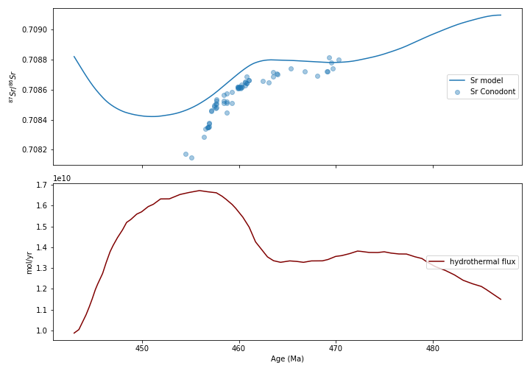
Model ver.01

Slide 6
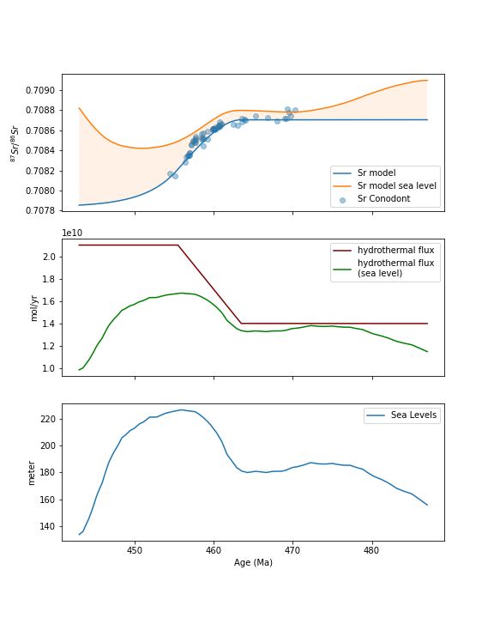
Comparison

